Slide 1

SYSTRONICS
Stock Aging Report 2026C
View and Print Aging Of Stock!

Slide 2
Aging of Stock
Stock is aged by separate locations or across all location
Aging is based on the receipt and assembly information
Optionally, I/C Adjustments and I/C Transfers are included in aging
Separate reports can be printed for all items or lot/serial ones
Lot/serial items are aged by their stock date or expiry date

Slide 3
Comparison with I/C Aged Inventory Report
SYSTRONICS Stock Aging Report | Sage 300 I/C Aged Inventory Report
Shows the quantity of item in the Inventory Grouped by item age | Shows inventory related transactions in their respective periods

Slide 4
Sample Product Screens

Slide 5
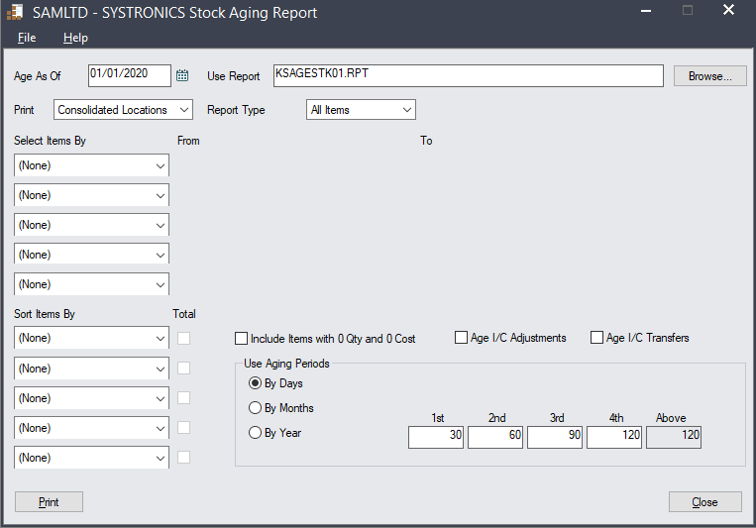
Report Selection Screen
(Desktop Version)

Slide 6
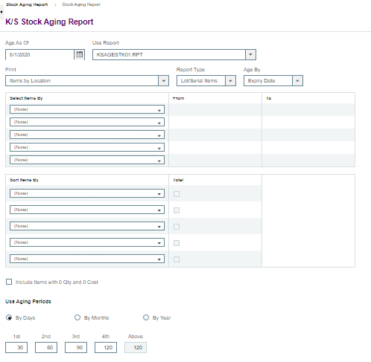
Report Selection Screen
(Web Version)

Slide 7
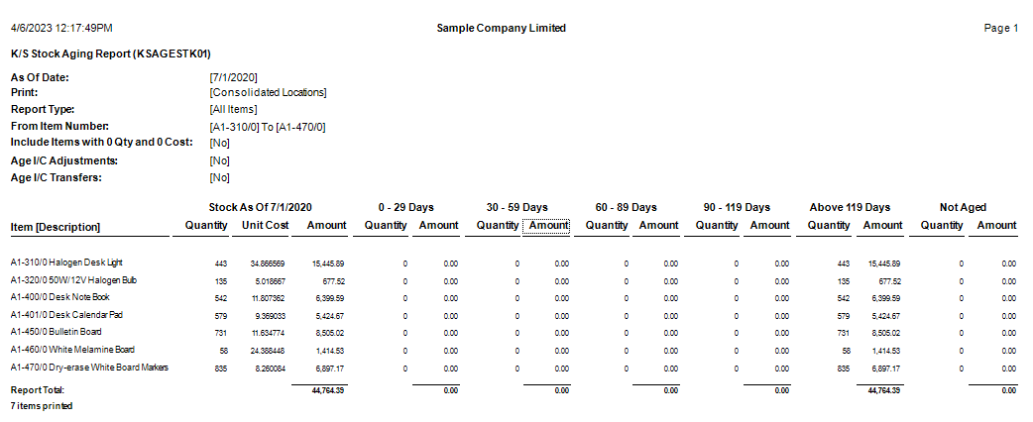
Report Layout
(Report Type: All Items)

Slide 8
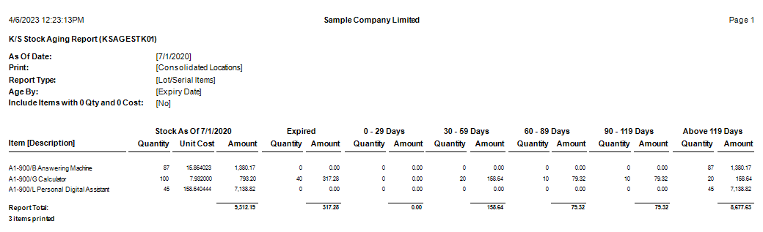
Report Layout
(Report Type: Lot/Serial Items)

Slide 9
Thanks
SYSTRONICS llc
sales@systronics.com
+(971) 4 393 0153
http://www.systronics.com/

