Slide 1
Voucher Bundle 2017A
Vouchers for Sage 300 transactions
Notes:
Required Slide
It’s a good idea to state the title of your session early and remind participants of any prerequisites, experience level, or other issues that might limit the session’s applicability for anyone. That way, participants can leave early to find a more appropriate session.
Tips for Capitalization and Punctuation for all slides:
Slide titles should be Title case – Every Major Word is Capitalized.
Slide bullets can either be title case or sentence case. With sentence case, you punctuate the bullet like you would punctuate a sentence, capitalizing only proper names or titles.
Construct all of your bullets consistently. If one bullet is a complete sentence, all bullets should be complete sentences. Alternately, all bullets could be phrases.
Use periods with bullets only if the bullet is a complete sentence.
The most important thing to remember is that you be consistent in your capitalization and punctuation. Ideally, you would be consistent across all slides, but at a minimum, use consistent capitalization and punctuation on any given slide.

Slide 2
Overview
Vouchers are printed for the following Sage 300 transactions:
  A/P Invoice
  A/P Adjustment
  A/P Payment
  A/R Invoice
  A/R Receipt
  A/R Adjustment
  G/L Journal Voucher
Each voucher demonstrates header level information, affected G/L accounts with amounts, total amount and signature areas
Vouchers are printed both for saved and posted transactions.
Demonstrate the affected G/L accounts even before the transactions are posted.
The amounts are shown both in source and functional currency

Slide 3
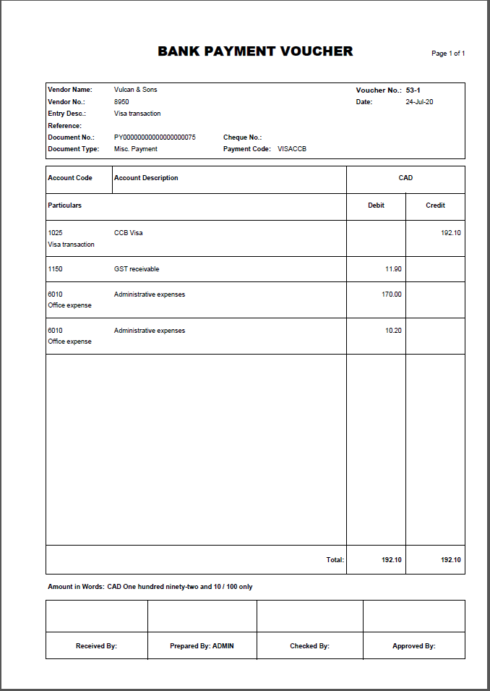
A/P Payment Voucher

Slide 4
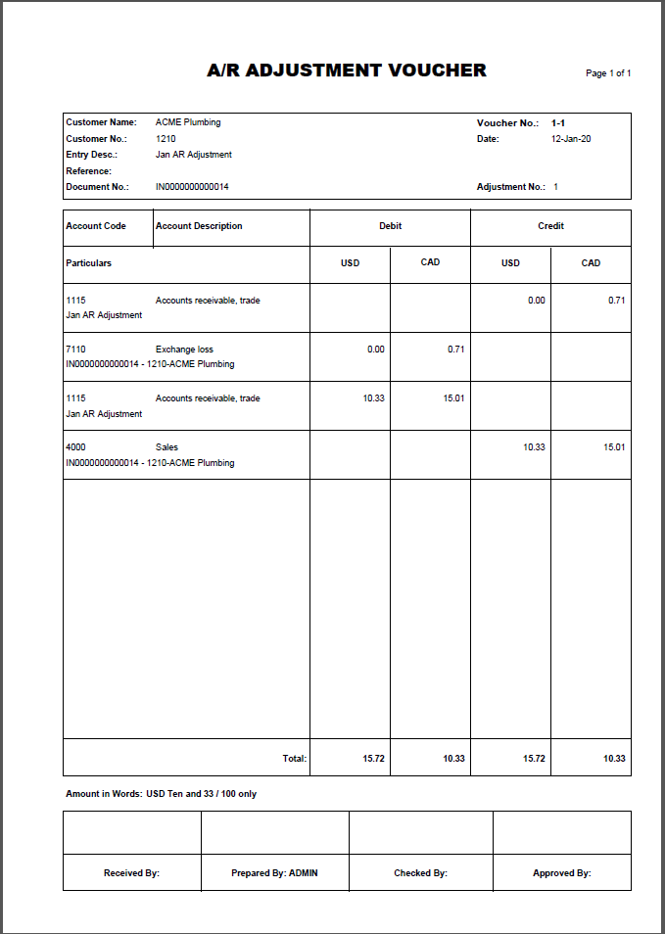
A/R Adjustment Voucher

Slide 5
Business Benefits
Better management of internal information.
Increased control over and reliability of printed information.
Readily available templates to apply any changes fitting your own requirements

Slide 6
Questions and Answers?
For more information, please contact Sales@Systronics.com

